Slide 1


Predicting Stock Price
Dipika Sharma

Slide 2

Stock Price
Part of company ownership is Stock.
Who purchase the stocks are stockholders.
Company grow or falls the stock price also increase or decrease.
Stock Market have important role in economy.

Slide 3
Goal
A model that predicts future Stock price trends.
Predict trends can reduce loss and can increase profit.
Beneficial for investment firms, financial institutes, and stock market investors.

Slide 4
Dataset: Source
Downloaded Stock data from Yahoo cite.
Jan 2015 to Sep 2021
Tesla Stock Price data.

Slide 5
Dataset: Features
7 attributes
Date: Relevant Transaction Day.
Open: Initial share price of the relevant Trading Day.
High: Highest price of the relevant Trading Day.
Low: Lowest price of the relevant trading day.
Close: Closing price of the stock on the relevant trading day.
Adj Close: Adjusted closing price of the stock of the relevant trading day.
Volume: Trading volume.

Slide 6
Model Features
Using Date and Close features for time series forecasting.
Date: Relevant Transaction Day.
Close: Closing price of the stock on the relevant trading day.

Slide 7
Data Understanding
1699 rows.
No missing values.
No outliers.

Slide 8
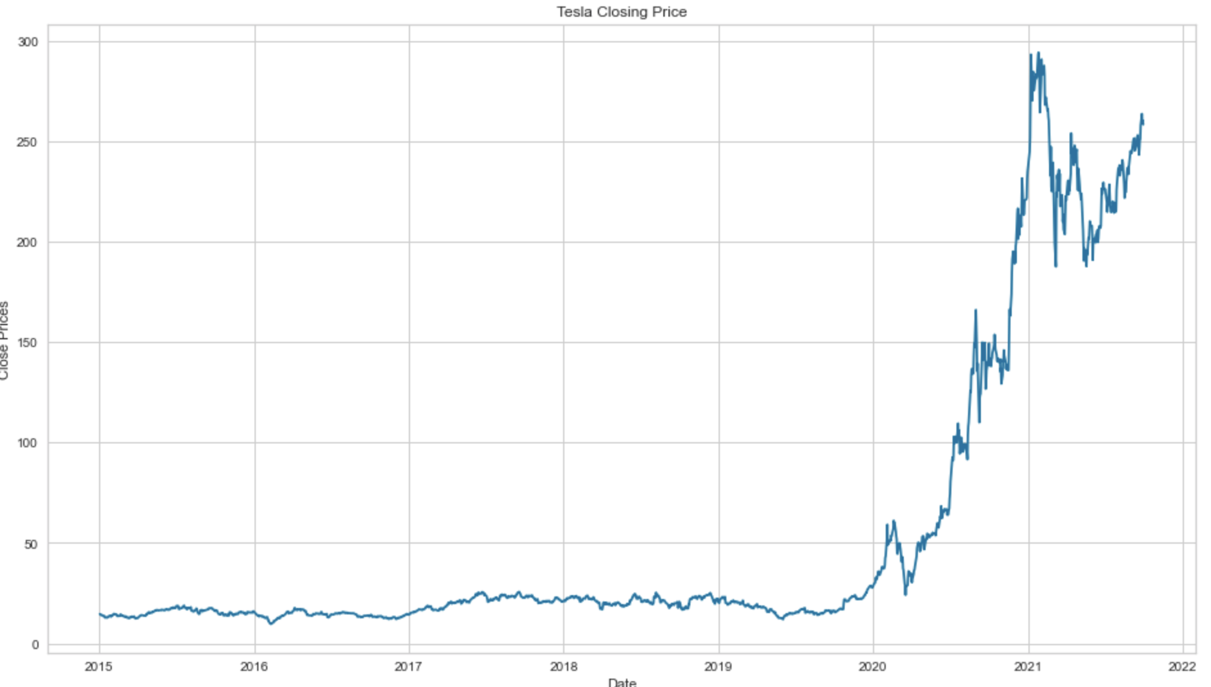
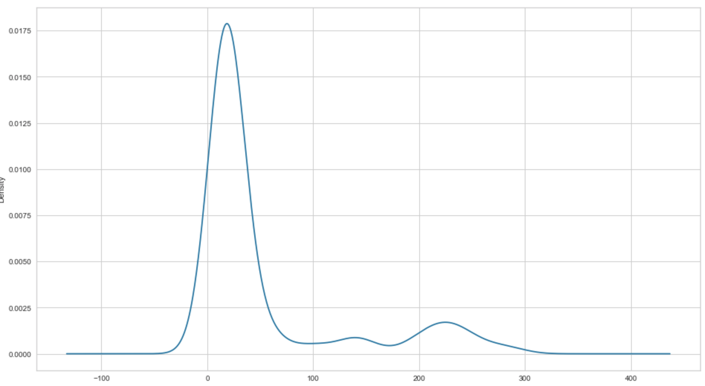
Visualization
Stock price growth from 2015 to 2021 years.
Constant increase in stock price.
High probability around 190 0r 260 and
Low probability >320.

Slide 9
Methodology: Algorithms
ARIMA Model
LSTM model

Slide 10
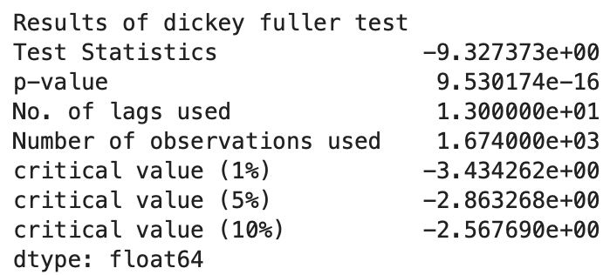
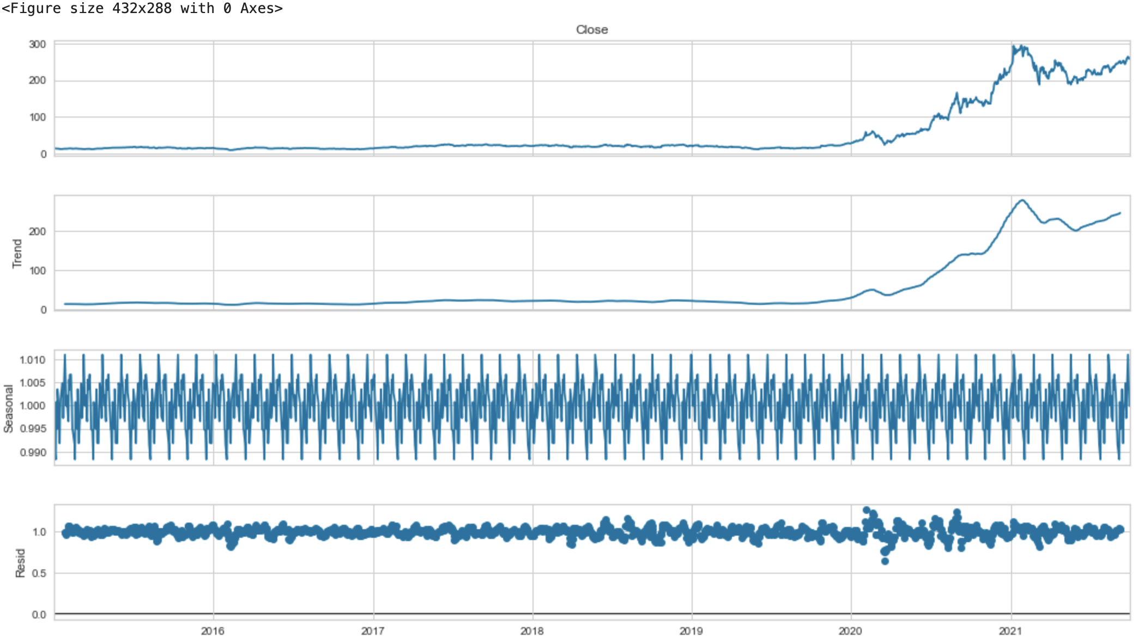
Methodology: Data Preparation
ADF (Augmented Dickey-Fuller)
Decompose
auto_arima
Split dataset to training and testing.

Slide 11
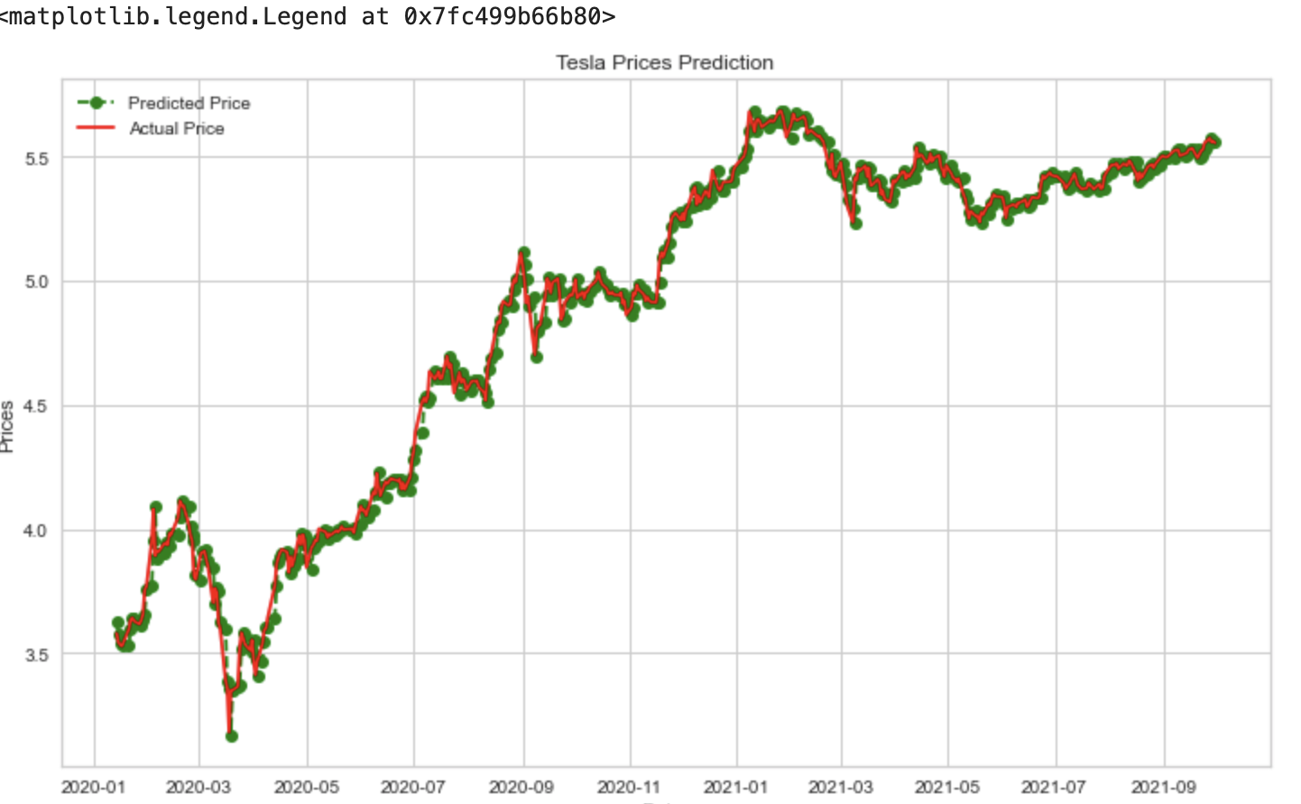
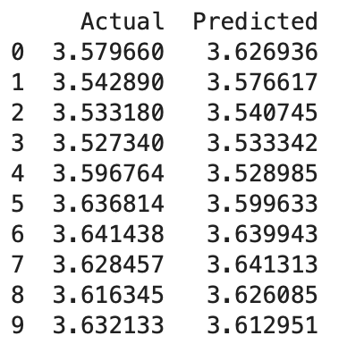
Methodology Results - ARIMA
Actual values and Predicted values are matching approximately.
Built ARIMA model is predicting the stock price closely.
Actual Price (red)
Rolling forecast predictions (Green).
values show some trend and are in the correct scale.

Slide 12
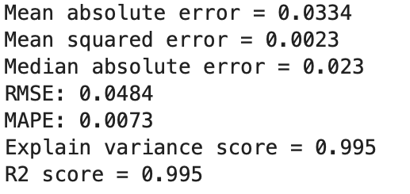
Results: Evaluation - ARIMA
R2 score is near 1
mean squared error is low
MAPE is lower
explained variance score is high
Results indicate built model can predict future values.

Slide 13
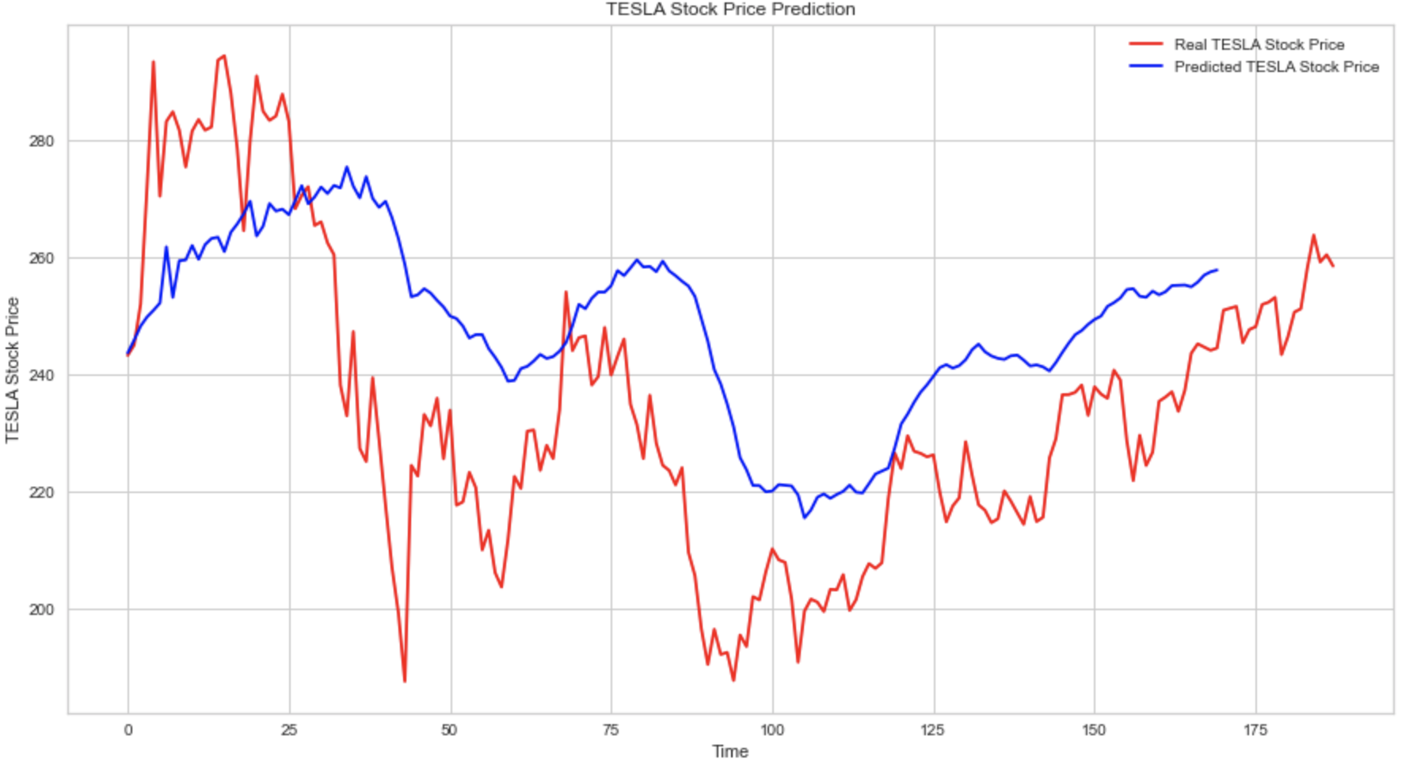
Methodology Results - LSTM
Actual Price (red)
Predicted Stock Price in blue
Follow most unusual jumps/drops.

Slide 14
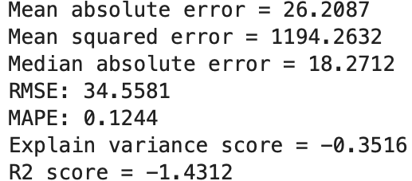
Results: Evaluation - LSTM
Able to predict future values.
R2 score is negative
mean squared error is low
MAPE is lower
explained variance score is negative

Slide 15
Conclusion
Coefficient MS, MAE, RMSE, MAPE, R2 and explained variance score show built model is working.
Results are encouraging.
ARIMA model is best fit.
Further Research

Slide 16
Sources:
Adam Hayes. (April21, 2023). What is a Stocks? from https://www.investopedia.com/terms/s/stock.asp
https://finance.yahoo.com/quote/TSLA/history?p=TSLA
The Wall Street Journal; Tesla historical Data; https://www.wsj.com/market-data/quotes/TSLA/historical-prices
Computing Regression Accuracy; https://subscription.packtpub.com/book/data/9781789808452/1/ch01lvl1sec12/computing-regression-accuracy

